Slide 1
Icosabutate, a Novel Structurally Engineered Fatty Acid, Significantly Reduces Relevant Markers of NASH and Fibrosis in 16 weeks: Results of an Interim Analysis of the Phase 2b ICONA Trial
Stephen Harrison¹, Nadege Gunn², Muhammad Y. Sheikh³, Madhavi Rudraraju⁴, Anita Kohli⁵ , Guy Neff⁶, David Fraser⁷, Kathline Kim⁷, Carine Beysen⁷, Stephen Rossi⁷, Arun Sanyal⁸ on behalf of the ICONA Trial Investigators
¹ Radcliffe Dept of Medicine, University of Oxford, UK, ² Pinnacle Clinical Research, Austin, USA, ³Fresno Clinical Research Center, Fresno, USA, ⁴Pinnacle Clinical Research, San Antonio, USA, ⁵Arizone Liver Health, Chandler, USA, ⁶Covenant Research, Sarasota, USA, ⁷NorthSea Therapeutics, Amsterdam, Netherlands, ⁸ Virginia Commonwealth University, Richmond, USA

Slide 2
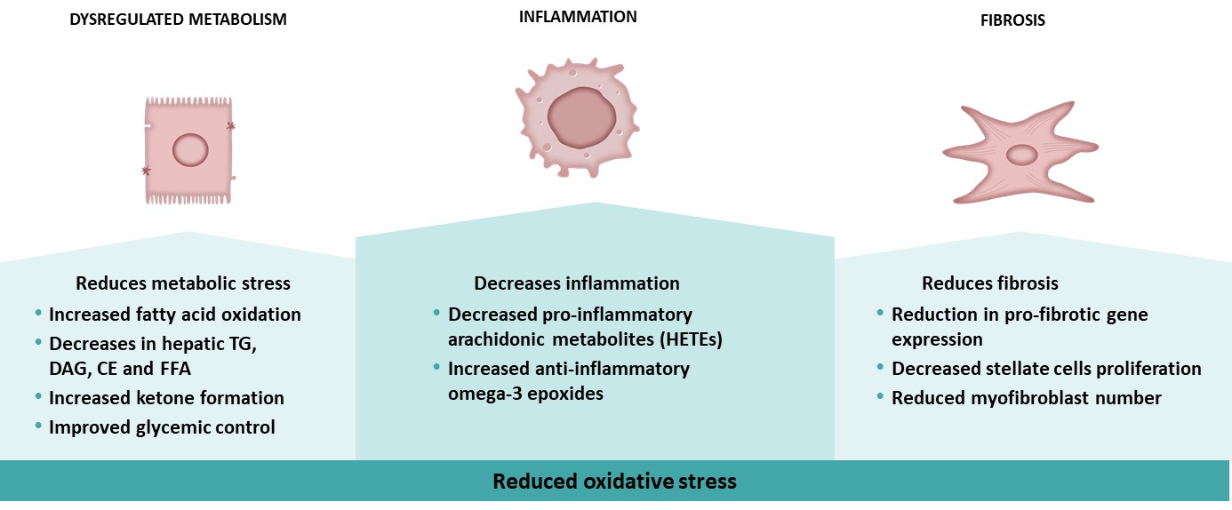
Icosabutate Mechanism of Action Pleiotropic Effect on Multiple Drivers of NASH Pathogenesis
Icosabutate (ICOSA) is an oral, liver-targeted engineered fatty acid with potent anti-inflammatory and antifibrotic activity
ICOSA is a full FFAR4 β-arrestin2 agonist which inhibits multiple pro-inflammatory cascades
Signaling via other pathways (PPAR-α and arachidonic acid cascade) further contribute to the anti-inflammatory and anti-fibrotic activity

Slide 3
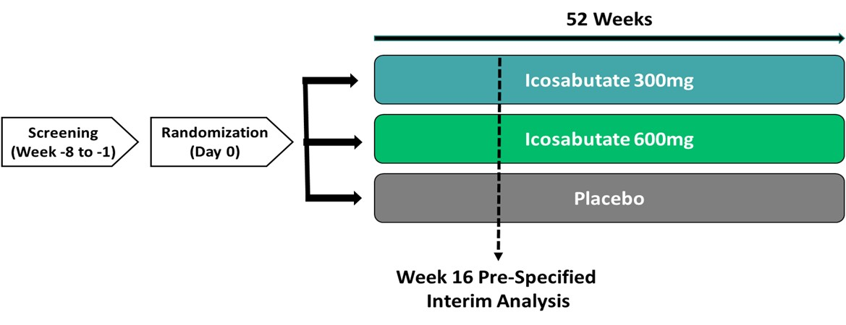
ICONA Trial Interim Analysis Overview of Study Design
The ICONA trial is an ongoing 52-week, multicenter, placebo-controlled, Phase 2b study enrolling 264 subjects with biopsy confirmed NASH
Participants were randomized (1:1:1) to placebo vs ICOSA 300mg or 600 mg
Interim analysis at Week 16 was performed in the first 90 randomized participants evaluating multiple non-invasive biomarkers relevant for NASH, fibrosis, metabolic syndrome, lipid metabolism and cardiovascular risk
The prespecified hierarchal interim analysis evaluated key parameters ranked in order of importance to ICOSA mechanism of action: ALT, GGT, TG, Pro-C3, cT1 and MRI-PDFF

Slide 4
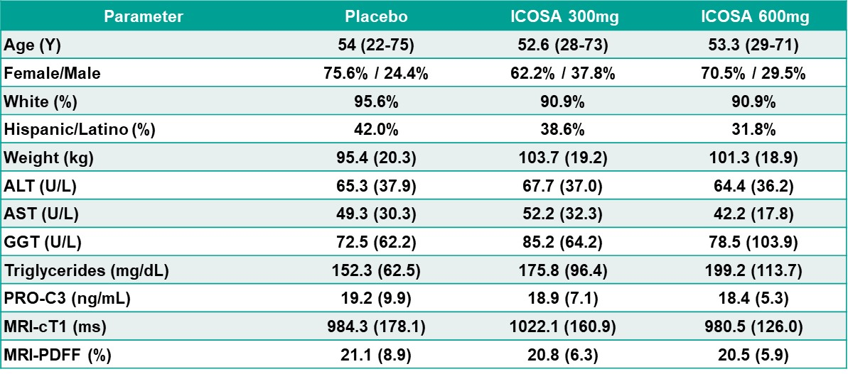
ICONA Trial Interim Analysis Baseline Patient Characteristics Comparable Across Treatment Arms

Slide 5
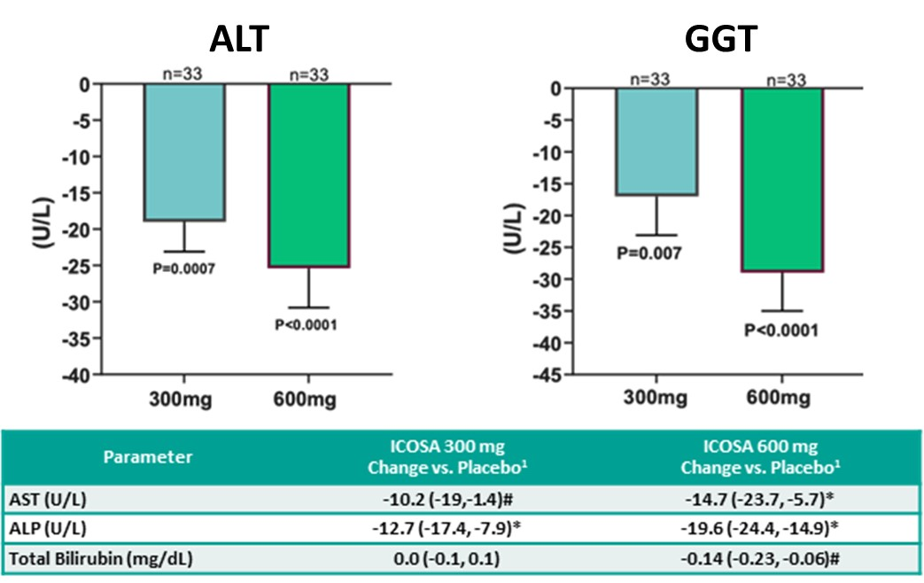
ICONA Trial Interim Analysis Decreases in Liver Enzymes Support an Impact on Inflammation and Oxidative Stress
¹ LS means (95% CI) *p< 0.001 #p<0.05

Slide 6
ICONA Trial Interim Analysis Robust Decreases in hsCRP Further Supports Potent Anti-inflammatory Activity

Slide 7
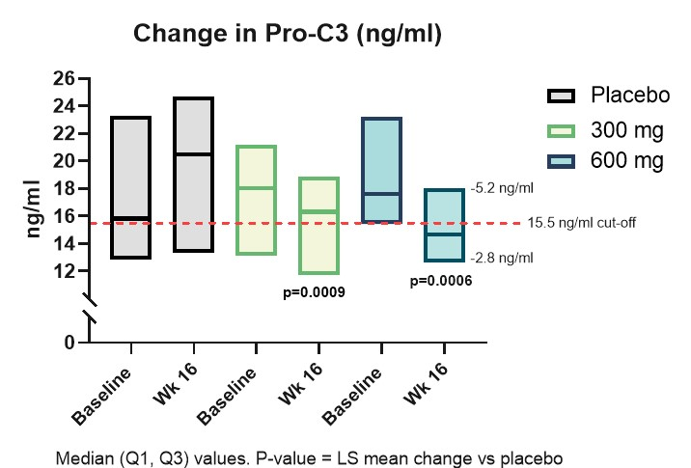
ICONA Trial Interim Analysis Significant and Clinically Meaningful Decreases in Markers of Fibrogenesis
Parameter | ICOSA 300 mg Change vs. Placebo¹ | ICOSA 600 mg Change vs. Placebo¹
Total ELF Score | -0.4 (-0.7, -0.1)# | -0.5 (-0.8, -0.3)*
PIIINP | -2.7 (-4.4, -1.0)# | -3.0 (-4.6, -1.3)*
TIMP-1 | -14.0 (-35.7, -7.7) | -23.6 (-45.4, -1.8)#
Hyaluronic Acid | -35.1 (-65.8, -4.3)# | -34.1 (-64.1, -4.1)#

Slide 8
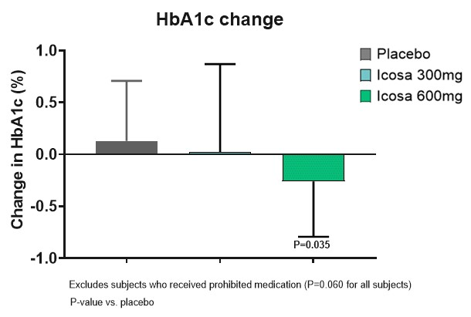
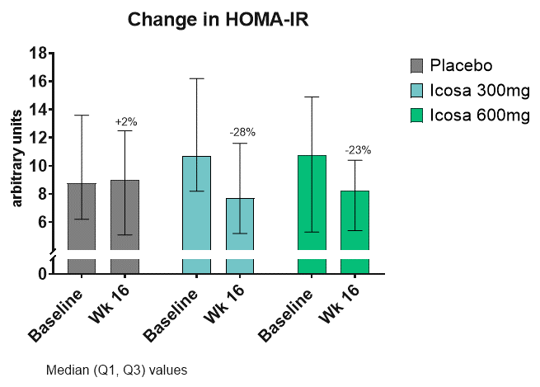
ICONA Trial Interim Analysis Improvements in Glycemic Control Consistent with FFAR4 Activity

Slide 9
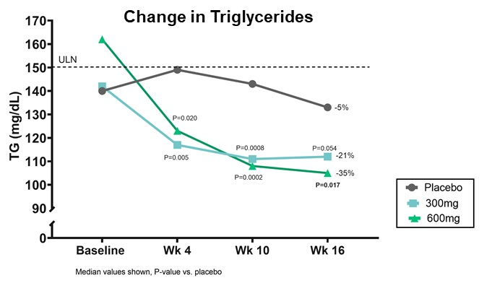
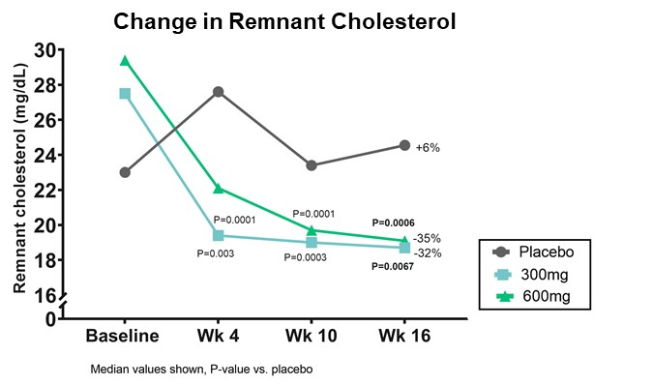
ICONA Trial Interim Analysis Decreases in Key Lipids Demonstrates Potent Target Engagement
Parameter | ICOSA 300 mg Change vs. Placebo ¹ | ICOSA 600 mg Change vs. Placebo ¹
Triglycerides(mg/dL) | -27.1 (-54.6, 0.5) | -34.0 (-61.9, -6.1)#
ApoC3 (mg/dL) | -1.6 (-3.0, -0.2) | -2.7 (-4.1, -1.3)*
Remnant-C (mg/dL) | -6.1 (-10.5, -1.8)# | -8 (-12.5, -3.6)*
LDL-C (mg/dL) | 5.5 (-5.5, 16.6) | -3.9 (-14.9, 7.1)
HDL-C (mg/dL) | 3.2 (0.0, 6.3) | 2.3 (-0.9, 5.4)
Total Cholesterol (mg/dL) | 2.5 (-9.2, 7.5) | -9.5 (-9.5, -15.1, 1.5)
ApoB (mg/dL) | -0.8 (-9.2, 7.5) | -6.8 (-15.1, 1.5)
Lipoprotein-a (mmol/L) | -5.2 (-11.2 , 0.9) | 1.5 (-4.6, 7.5)
¹ LS means (95% CI) *p< 0.001 #p<0.05

Slide 10
ICONA Trial Interim Analysis Hepatoprotective Effects Independent of Changes in Liver Triglycerides

Slide 11
ICONA Trial Interim Analysis Overall ICOSA Safety Comparable to Placebo
 | Placebo | ICOSA 300mg | ICOSA 600 mg
Any TEAE | 37 (80.4%) | 30 (65.2%) | 37 (78.75)
Maximum Severity
Grade 1 | 12 (26.1%) | 7 (15.2%) | 9 (19.1%)
Grade 2 | 24 (52.2%) | 22 (47.8%) | 20 (42.6%)
Grade 3 | 1 (2.2%) | 1 (2.2%) | 4 (8.5%)
Grade 4 | 0 | 0 | 0
Grade 5 | 0 | 0 | 0
Drug Related TEAE | 7 (15.2%) | 7 (15.2%) | 8 (17%)
SAE | 1 (2.2%) | 1 (2.2%) | 3 (6.4%)
Related SAE | 0 | 0 | 0

Slide 12
ICONA Trial Interim Analysis Favorable Safety and Tolerability Profile
The treatment well tolerated and comparable to placebo except for mild nausea (4.3%, 9.0% and 21.3% in placebo, 300mg and 600mg, respectively)
No significant changes in body weight during the treatment period
No confirmed drug-induced liver injury, cardiovascular events or worsening of diabetes
Laboratory values remained stable or improved
No clinically relevant changes in vital signs or ECGs
No safety or tolerability signals of concern were observed; confirmed by an independent unblinded DSMB review
Safety and tolerability of icosabutate remains favorable and similar to that observed in other relevant patient populations

Slide 13
ICONA Trial Interim Analysis Summary
In patients with biopsy confirmed NASH, ICOSA has demonstrated;
Rapid and significant reductions in biomarkers of liver injury and inflammation
Significant reduction in multiple biomarkers of fibrosis
The effects of ICOSA, in contrast to the complete lack of effect seen in the placebo group, supports the possibility of achieving a significant treatment effect on the primary endpoint
Favorable safety and tolerability observed at both doses
Additional improvements in atherogenic lipids/lipoproteins and glycemic control add beneficial effect on CV risk

